Slide 1
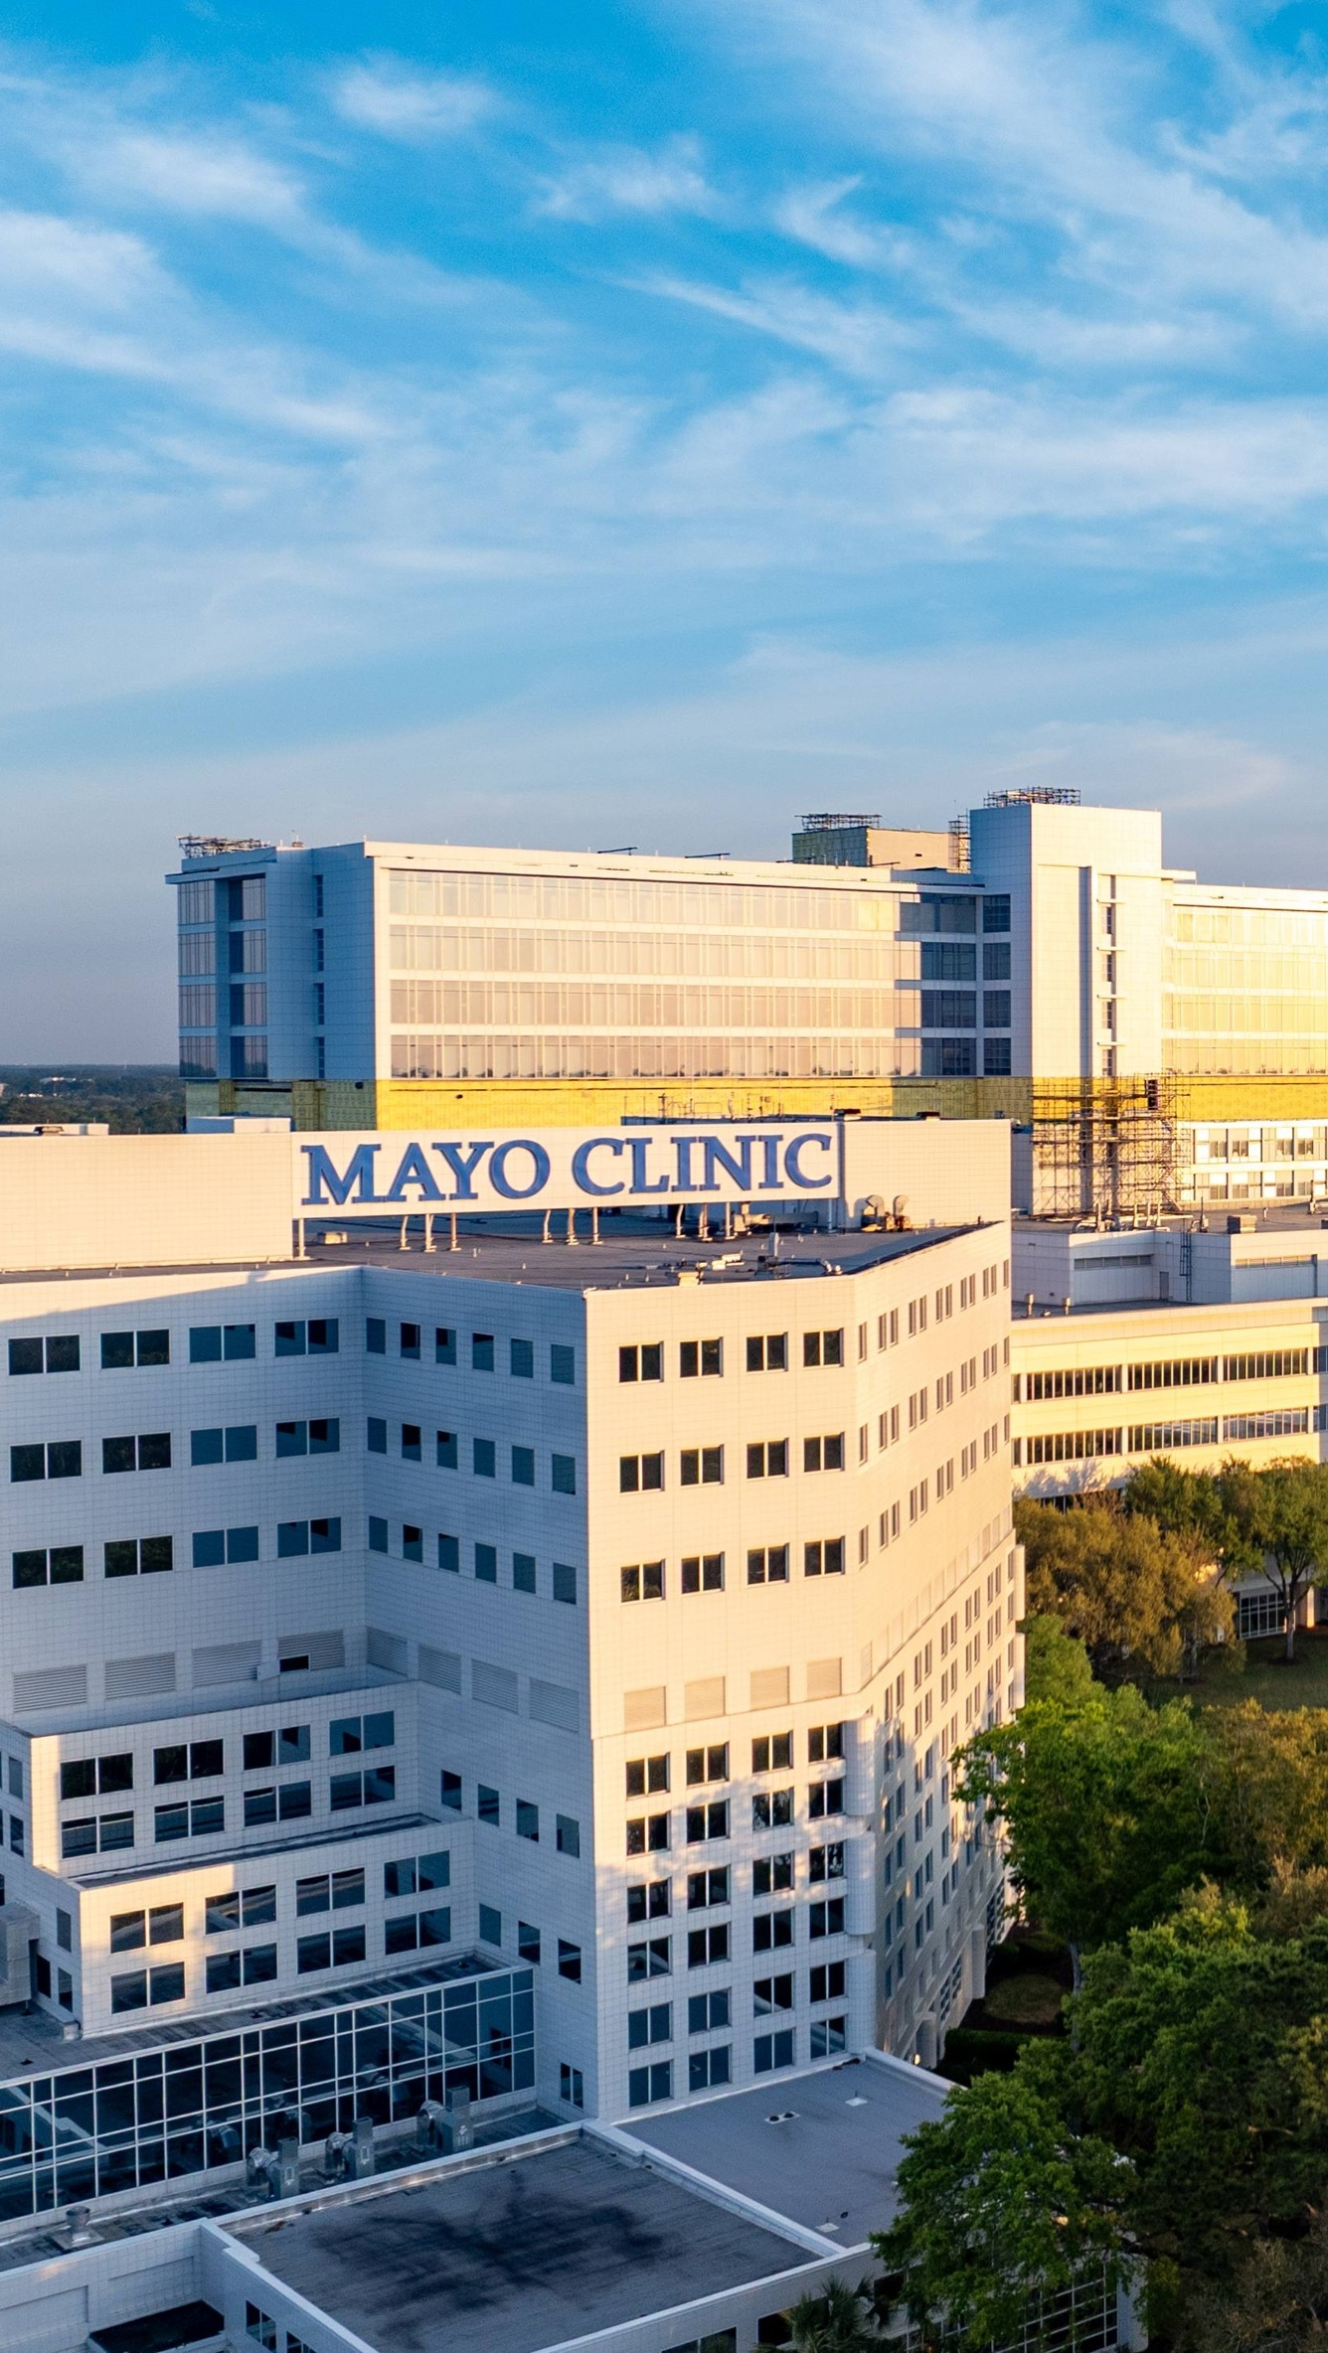


OPPORTUNITY REVIEW
DIRECT-TO-EMPLOYER GTM STRATEGY
Exploring a Mayo Clinic Jacksonville DTE Health Plan

Slide 2


Founded in 1979, headquartered in Indianapolis
Largest Independently-Owned Full-Service Third-Party Administrator
Specialize in Administration of Self-Funded Plans and Population Health Management​
Leader in the Direct-to-Employer Movement
We Know and Understand the Market
Experience Working with All Professional Teams: Agents, Networks, MGAs
The Key Family of Companies is a Vertically Integrated group of benefit related organizations
3,000+ Corporate Clients
3 Million Members under Management
700 Employees

Slide 3


MARKET LEADER
IN
PRIVATE LABELED
DTE PLANS
Louisville, KY
OneHealth Plan
Cincinnati, OH
TCH Optimal
Bentonville, AR
Northwest Health Plan
Knoxville, TN
East Tennessee Health Plan
Meridian, MS
Affinity Health Plan
Fort Myers, FL
Lee Health Care Partners

Slide 4


DIRECT-TO-EMPLOYER (DTE)
YOU Pick the Name of the Health Plan
YOU Determine the Fees Charged
YOU Practice the Medicine
YOU Receive the Profits
WE Make it Successful
Your Health Plan Focused on a Direct Relationship with Self-Funded Employers in Your Market

Slide 5
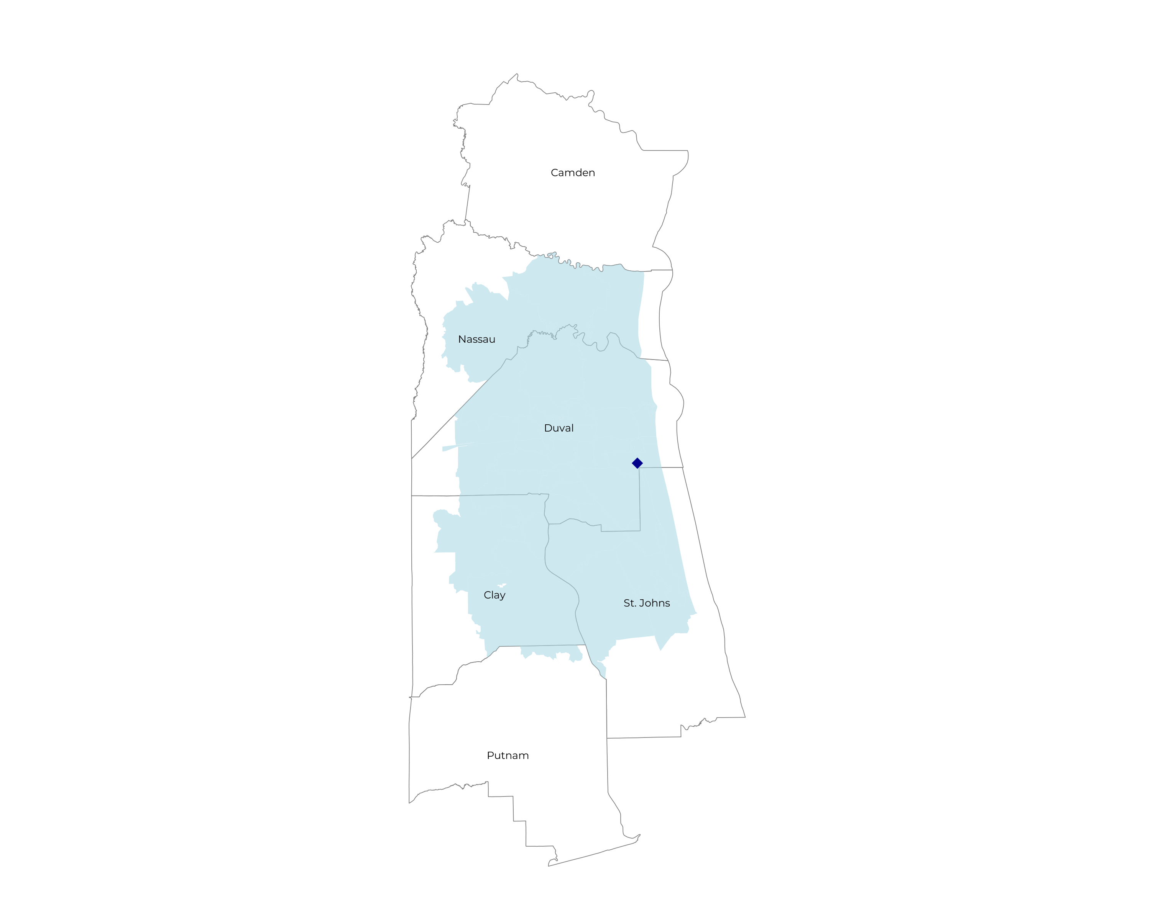
SIGNIFICANT OPPORTUNITY FOR PLAN GROWTH Researched for the below highlighted service area
Target Market 1,500+ Employers 300,000+ Employees 700,000+ Members
 | Employer Size Group (# of Employees)
Commercial Employers With Headquarters | 50-100 | 101-200 | 201-400 | 401-1,000 | 1,001-3,000 | 3,000+
In Catchment Area | 961 | 372 | 215 | 154 | 55 | 31
Total Employees at Employers | 50-100 | 101-200 | 201-400 | 401-1,000 | 1,001-3,000 | 3,000+
Headquartered in Catchment Area | 72,100 | 55,800 | 64,500 | 107,800 | 110,000 | 186,000
Total Members with Employers | 50-100 | 101-200 | 201-400 | 401-1,000 | 1,001-3,000 | 3,000+
Headquartered in Catchment Area | 129,800 | 100,400 | 116,100 | 194,000 | 198,000 | 334,800

Slide 6
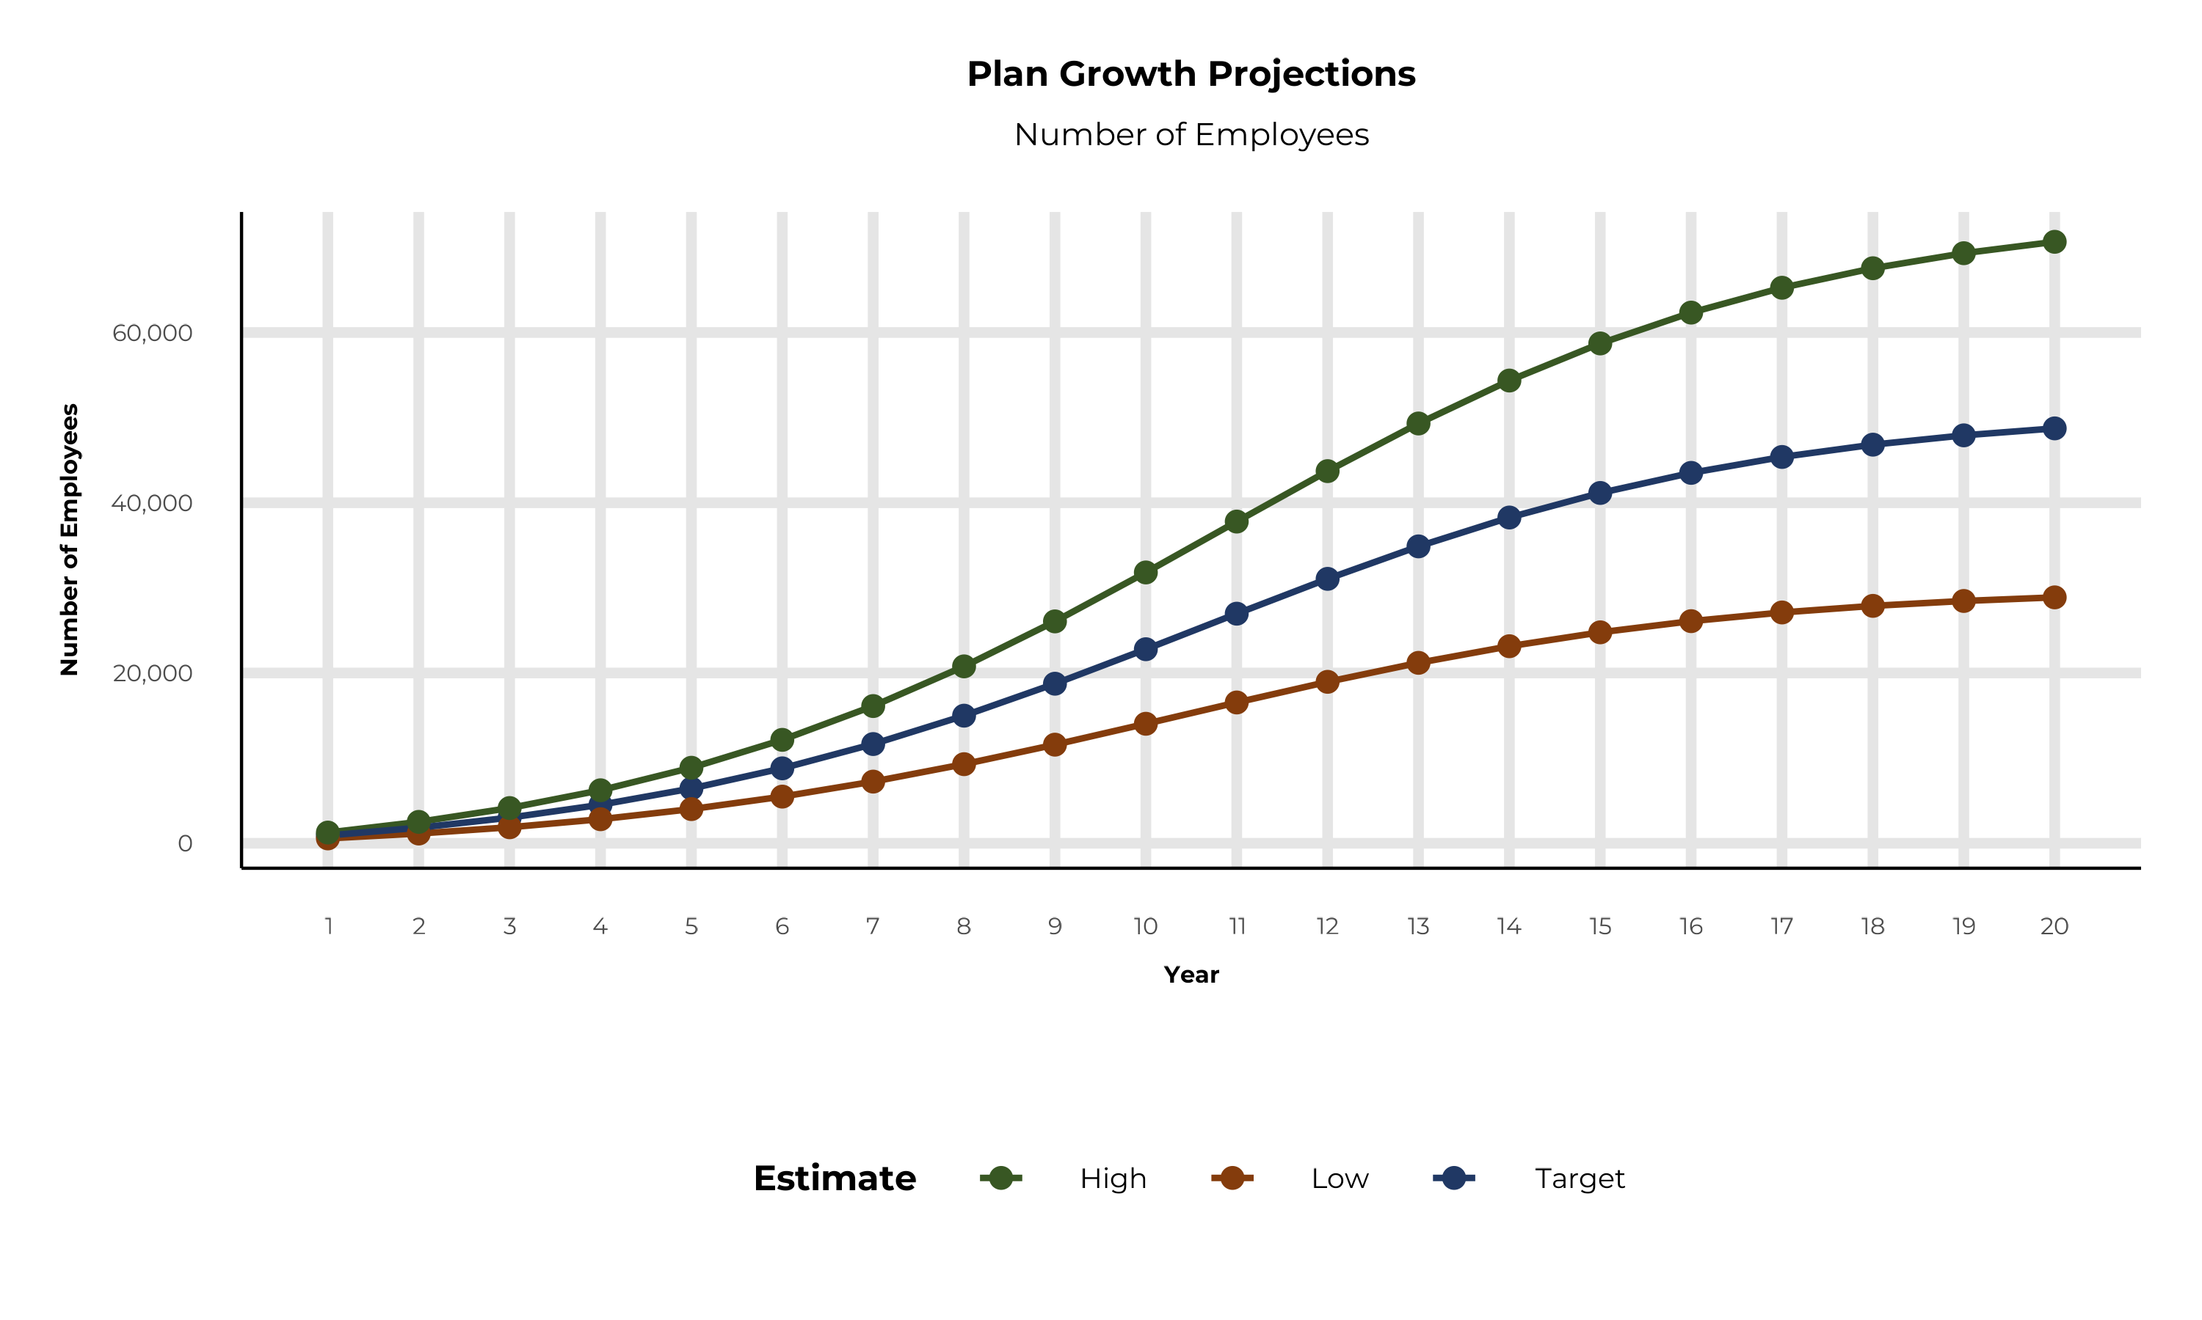
PLAN POTENTIAL GROWTH PATHS
Self Funded
334K
Insured
551K
Working Age
823K
Population
1,403K
Estimates includes the Mayo Clinic Jacksonville service area in Clay, Duval, Nassau, and St. Johns Counties

Slide 7
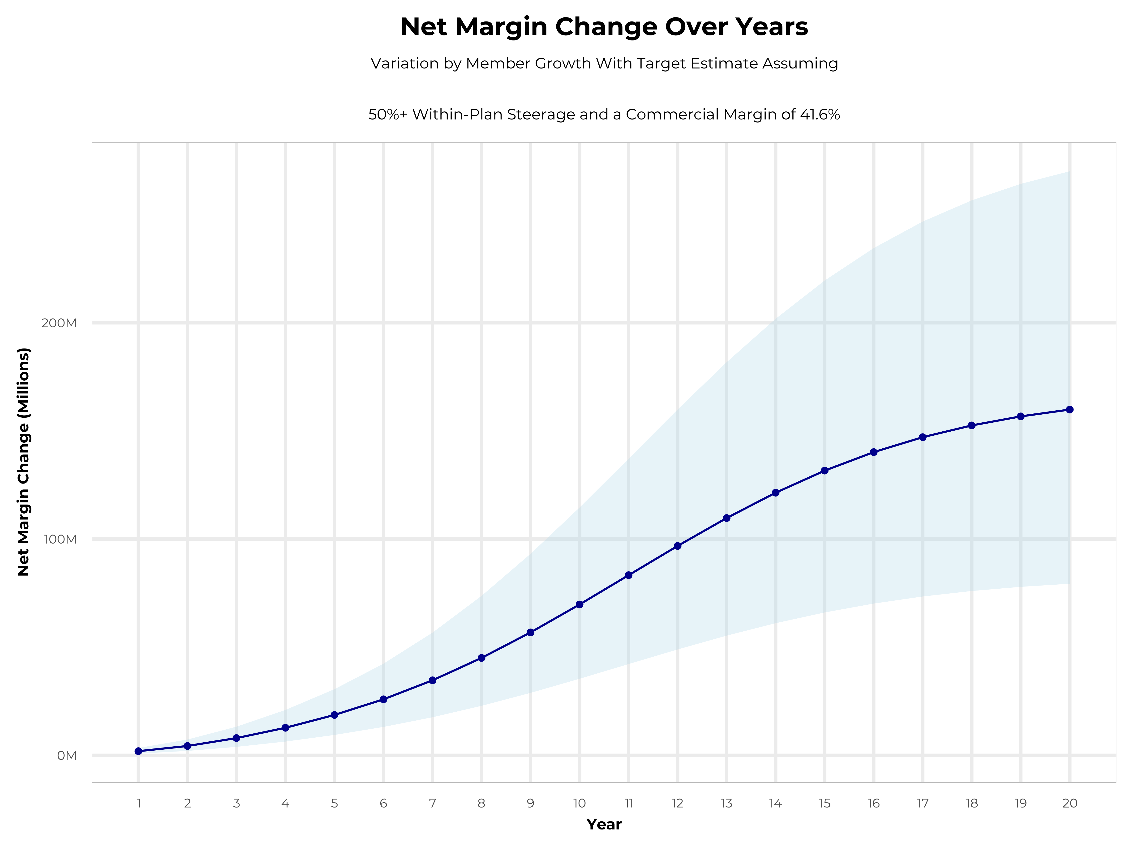
GROWING POWERFUL, LASTING PROFITABILITY
Early Stage
Gaining Name Recognition, Early Growth
New Revenue:
New Profit:
$28.89M
$11.91M
Growth Stage
Strong Reputation, Strong Growth
New Revenue:
New Profit:
$169.47M
$70.87M
Mature Stage
High Profitability, Market Saturation
New Revenue:
New Profit:
$344.53M
$144.21M

Slide 8
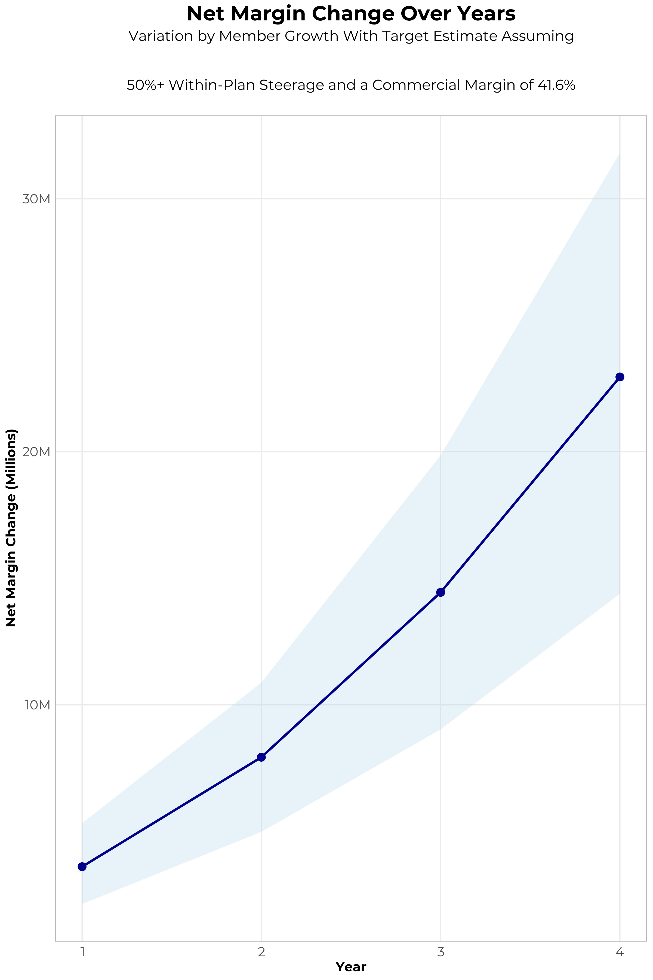
FOUR-YEAR PROJECTIONS
Target Member Growth | Target Member Growth | Target Member Growth | Target Member Growth | Target Member Growth
Metric | Year 1 | Year 2 | Year 3 | Year 4
Number of Members | 1,600 | 3,300 | 5,400 | 8,100
Incremental Margin | 3,912.6K | 8,069.7K | 14,559.8K | 23,039.3K
Network Access Fee | 19.2K | 39.6K | 64.8K | 97.2K
Implementation Fee (One-Time) | -150.0K | 0.0K | 0.0K | 0.0K
Sales and Marketing Costs | -180.0K | -180.0K | -180.0K | -180.0K
Net Margin Change | 3,601.8K | 7,929.3K | 14,444.6K | 22,956.5K
High Member Growth | High Member Growth | High Member Growth | High Member Growth | High Member Growth
Metric | Year 1 | Year 2 | Year 3 | Year 4
Number of Members | 2,300 | 4,500 | 7,400 | 11,200
Incremental Margin | 5,624.3K | 11,004.1K | 19,952.3K | 31,856.9K
Network Access Fee | 27.6K | 54.0K | 88.8K | 134.4K
Implementation Fee (One-Time) | -150.0K | 0.0K | 0.0K | 0.0K
Sales and Marketing Costs | -180.0K | -180.0K | -180.0K | -180.0K
Net Margin Change | 5,321.9K | 10,878.1K | 19,861.1K | 31,811.3K
Low Member Growth | Low Member Growth | Low Member Growth | Low Member Growth | Low Member Growth
Metric | Year 1 | Year 2 | Year 3 | Year 4
Number of Members | 1,000 | 2,100 | 3,400 | 5,100
Incremental Margin | 2,445.4K | 5,135.3K | 9,167.3K | 14,506.2K
Network Access Fee | 12.0K | 25.2K | 40.8K | 61.2K
Implementation Fee (One-Time) | -150.0K | 0.0K | 0.0K | 0.0K
Sales and Marketing Costs | -180.0K | -180.0K | -180.0K | -180.0K
Net Margin Change | 2,127.4K | 4,980.5K | 9,028.1K | 14,387.4K

Slide 9
DIRECT-TO-EMPLOYER STRATEGY: ONLY AVAILABLE TO PREMIER HEALTH SYSTEMS
STRONG Brand Quality
EXTENSIVE Patient Access
AFFORDABLE Value Pricing
EXCELLENT Care Quality

Slide 10
MAYO CLINIC IS PATIENT RECOMMENDED
Health System | HCAHPS Recommendation Percentile | CMS Stars Percentile | Mortality Percentile | Readmission Percentile | KBA Brand Quality Score
Mayo Clinic | 98 | 100 | 82 | 76 | 78
Baptist Health (Jacksonville FL) | 74 | 87 | 72 | 72 | 71
Ascension Health | 53 | 54 | 79 | 57 | 63
University of Florida Health | 33 | 60 | 65 | 65 | 57
HCA Healthcare | 22 | 31 | 88 | 61 | 51
Based on quality measures and HCAHPS feedback, KBA estimates that Mayo Clinic Jacksonville has the strongest brand quality in Clay, Duval, Nassau, and St. Johns Counties.

Slide 11
PROJECTED PLAN GROWTH
Year | Employees | Members | Percent of Members Choosing Mayo Clinic Jacksonville for Inpatient Care | Percent of Members Choosing Mayo Clinic Jacksonville for Outpatient Care
1 | 900 | 1,600 | 60% | 50%
2 | 1,800 | 3,200 | 60% | 50%
3 | 3,000 | 5,400 | 65% | 55%
4 | 4,500 | 8,100 | 67% | 58%
5 | 6,400 | 11,500 | 68% | 60%
6 | 8,800 | 15,800 | 68% | 60%
7 | 11,700 | 21,100 | 69% | 61%
8 | 15,000 | 27,000 | 69% | 62%
9 | 18,700 | 33,700 | 69% | 62%
10 | 22,800 | 41,000 | 70% | 63%
11 | 27,000 | 48,600 | 70% | 63%
12 | 31,100 | 56,000 | 70% | 64%
13 | 34,900 | 62,800 | 71% | 64%
14 | 38,300 | 68,900 | 71% | 65%
15 | 41,100 | 74,000 | 71% | 66%
16 | 43,500 | 78,300 | 72% | 66%
17 | 45,400 | 81,700 | 72% | 66%
18 | 46,800 | 84,200 | 72% | 67%
19 | 47,900 | 86,200 | 72% | 67%
20 | 48,700 | 87,700 | 72% | 67%
KBA currently estimates that Mayo Clinic Jacksonville has 9% inpatient market share, and 5% outpatient market compared to hospitals/clinics in the Mayo Clinic Jacksonville service area (see slide 8).
Based on previous DTE experience, KBA expects a significant bump in patient steerage to Mayo Clinic Jacksonville.
Additional steerage will occur from additional steerage patient benefits and the patient card.
High estimates start nearly 10% higher than target with low estimates at 10% lower than target

Slide 12
YEAR 4 PROJECTED REVENUE AND PROFIT
Pre-DTE Cohort of 8,100 Employees | Inpatient | Outpatient | Professional | Total
Revenue† | $ 2,528,008 | $ 2,295,565 | $ 1,072,010 | $ 5,895,583
Net Income‡ | $ 1,051,651 | $ 954,955.2 | $ 445,956 | $ 2,452,562
† Assuming proportional revenues from market shares of 9% (inpatient) and 5% (outpatient)
‡ Conservatively assuming a commercial margin of 41.6% (80% of the estimated commercial margin)
With DTE | Inpatient | Outpatient | Professional | Total
Revenue⁰ | $ 18,495,209 | $ 29,004,759 | $ 13,544,976 | $ 61,044,945
Net Income* | $ 7,694,007 | $ 12,065,980 | $ 5,634,710 | $ 25,394,697
⁰ Assuming 67% inpatient and 58% market steerage based on KBA narrow network DTE experience (see previous slide)
* Conservatively assuming a commercial margin of 41.6%, with a 10 percentage-point reduction to reflect competitive-edge rates and a 10 percentage-point increase due to lower billing costs and higher patient responsibility collections because of the member credit card.
Total Increase in Net Income | $ 22,942,135
Network Access Fee (Revenue) of $1 PMPM | $ 97,200
Total Profit Growth | $ 22,946,935
Minus Implementation Fee (One-Time) | -$ 0
Minus Sales and Marketing (Annual – Ongoing) | -$ 180,000
Total | $ 22,859,335

Slide 13





A PARTNER YOU CAN TRUST
OUR OBJECTIVES ARE ALIGNED
WE KNOW THE
MARKET
COMPLETELY TRANSPARENT
WE HAVE THE SOPHISTICATION AND INFRASTRUCTURE TO EFFECTIVELY COMPETE
Derek Moore, Senior Vice President – KBA
845-283-9973 * derek.moore@keybenefit.com

